Slide 2
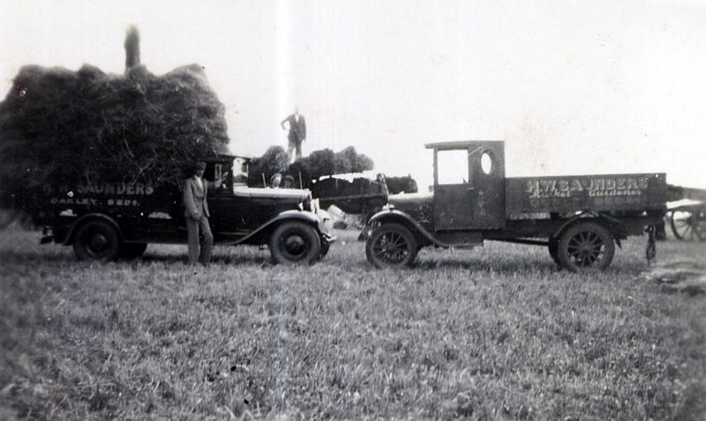
Local Business & Employment Policy

Slide 3
Local Business & Employment Policy
BE1 In order to maintain the character of the village we will only support proposals both for new and existing commercial operations within the curtilage of existing commercial premises or former industrial or commercial brownfield sites which do not conflict with other planning policies.
BE2 We will support the development of infrastructure and facilities which encourage the growth of home-based micro businesses.
BE3 In order to limit the flow of large vehicles through the village we will not support any proposals to widen or otherwise upgrade access to industrial sites.
BE4 Any commercial sites which are within 100 metres of areas of high sensitivity to development, as determined by either the Bedford Borough Council or Oakley Landscape Character Assessments, or adjacent to a housing development will be limited to B1 classification.

Slide 4
Highways & Transport Policy

Slide 5
Highways & Transport Policy
HT1 New development will be approved where there is no significant adverse impact on traffic congestion, on-street parking and road safety.
HT2 New development will keep street lighting to a minimum, sympathetic to the local setting and in line with the local identity. Excessive signage should be avoided.
HT3 New development should provide or improve roads, footpaths and cycleways in the vicinity of the development to ensure safe and environmentally friendly infrastructure.

Slide 6
Housing Growth Policy

Slide 7
Housing Growth Policy
HG 1 To enable growth within the parish
Development should prioritise Brownfield Sites first.
A small development (less than 20 dwellings) or medium development (20 – 40 dwellings) may be allowed in the village envelope.
A small development adjacent to the village envelope will be allowed as long as the proposals meet the proposals for mixed dwellings based on all the policies in the Plan and is consistent with the existing structure of the village.

Slide 8
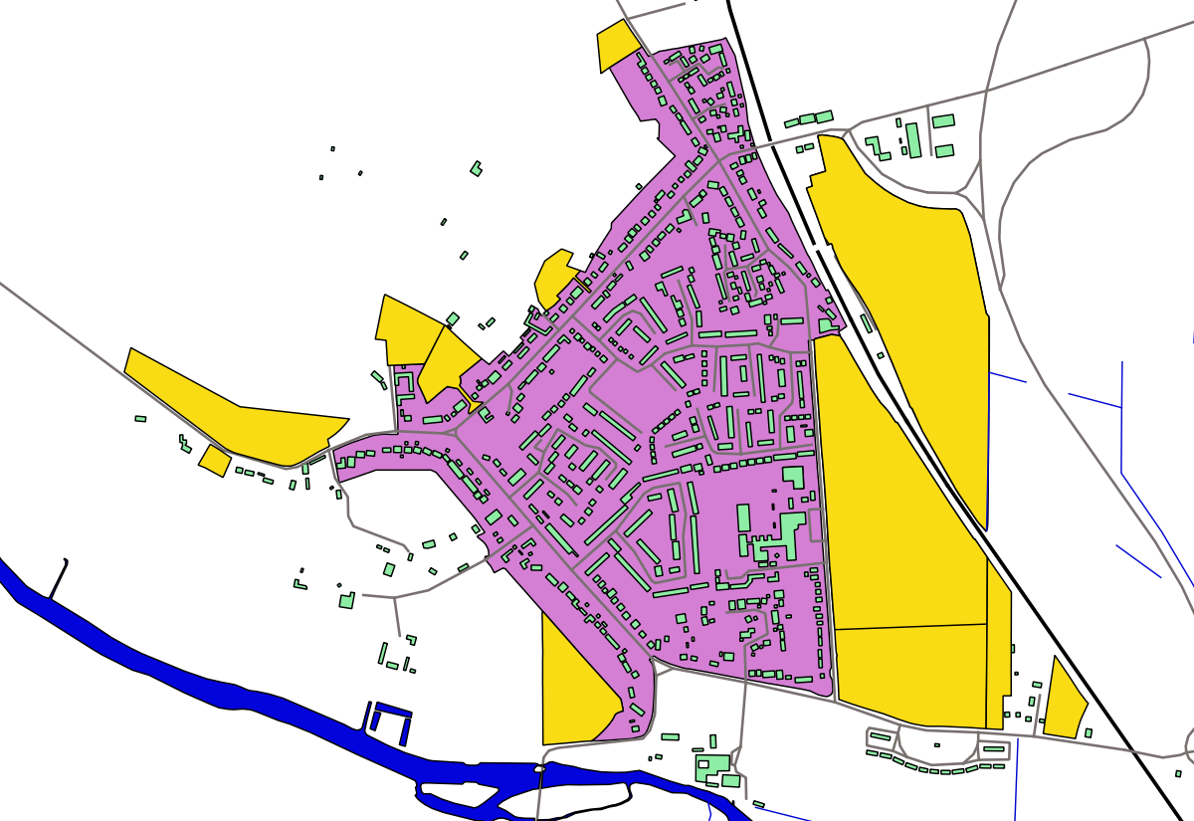
Proposed Development Sites
Proposed Sites
Current Settlement Area
Contains OS data © Crown copyright and database right (2017)

Slide 9
Housing Growth Policy
HG 2 To help identify the appropriate sites for development within the parish
Development should be on small sites.
New development should be within or adjacent to the existing settlement area(s)
Development should prioritise Brownfield Sites first.
Development should not have a detrimental impact on the open countryside.
Development should not have a detrimental impact on the views from the entrances and exits to and from Oakley
Development should not impact on the open spaces separating Oakley from adjacent villages.
The conversion of existing redundant, empty or derelict buildings to new dwellings would be supported.
Any proposed development on designated green spaces will not be approved.

Slide 10
Housing Growth Policy

Slide 11
Housing Growth Policy
HG 3 to help identify the type and scale of development
Housing development of 1, 2 or 3 bedroom dwellings will be approved.
Some single story houses will be approved.
New dwellings should complement existing building lines, front gardens and hedges where such features are important to the appearance and character of the location.
Small site developments as in policy 3 must have green spaces and follow the open character of all previous small site developments in the village.
Site developments or individual houses should be planted with hedging or trees on all the site boundaries to maintain the existing character of the roads in Oakley.

Slide 12
Proposed Development Sites
Proposed Sites
Current Settlement Area
Contains OS data © Crown copyright and database right (2017)

Slide 13
Housing Growth Policy
HG 4 Ensuring good quality design
New developments should integrate with the local surroundings, the landscape and the built environment
All new housing should use quality materials that complement the existing palette of materials used within the surrounding area.
Extensions should enhance and be subordinate to the scale of the building in terms of materials, design and structure.
New developments must have suitable access to the site for people of all abilities.
Parking must be located so that it does not dominate the street scene.
Garages should be designed to reflect the architectural design of the house they serve.
Hard surfaced driveways must be of a permeable material.
Layout of all developments must have adequate footpaths that incorporate safe cycling into and through the site and should allow natural surveillance
Lighting must be follow the same criteria as the rest of the lighting in the village.
Layouts of all developments must have a green area.
Layouts of all developments should follow the open aspects of the other small developments in the village with minimal planting and no fences to the frontages.
Cycle ports should be integrated into all dwellings
Bin storage must be integrated into all dwellings.
All street furniture should reflect other street furniture in the village and should be as minimal as possible.

Slide 14
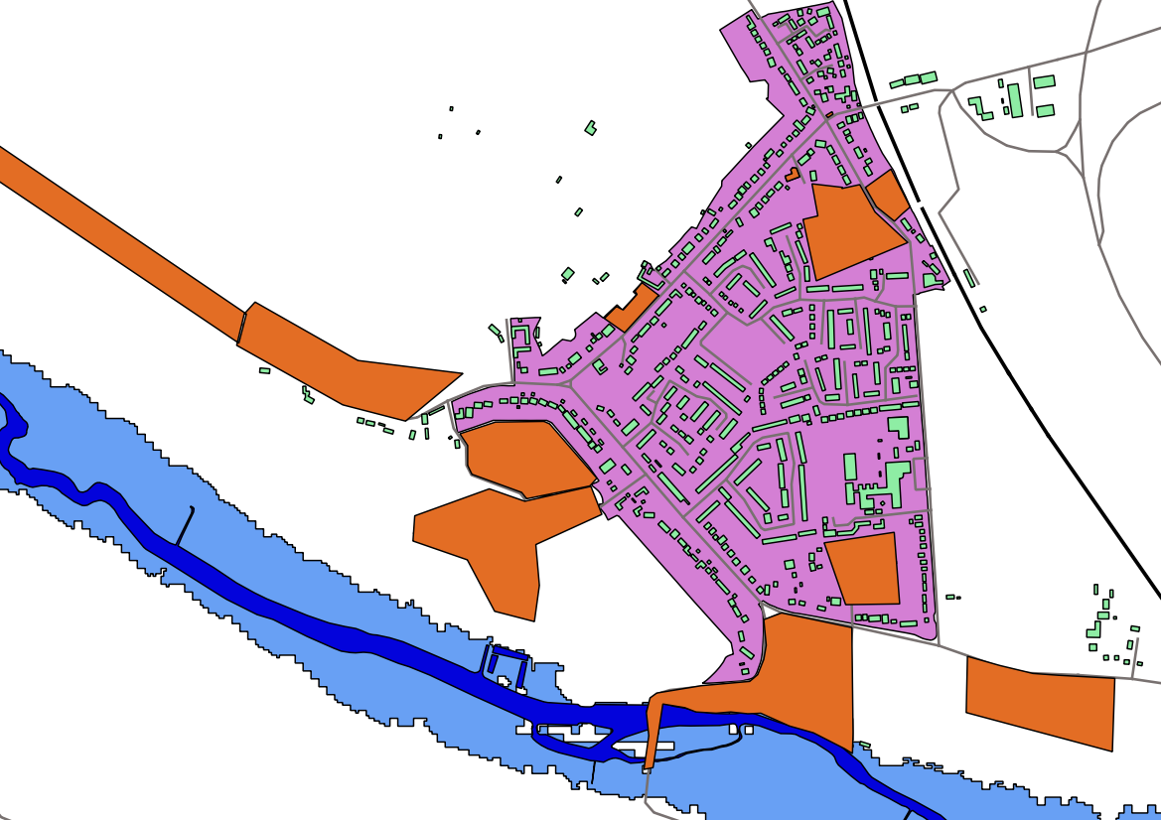
Heritage Areas
Heritage Areas
Flood Zone
Current Settlement Area
Contains OS data © Crown copyright and database right (2017)

Slide 15
Heritage Policy
H 1 New development must not impact on the settings, views or access to any of the buildings designated as village assets. (see Heritage poster)
Development will not be permitted within the area of the Church and the River Bridges.
Development around Oakley House and the Drive will not be permitted unless it enhances the setting of the Grade11* house and the surrounding landscape.
The former station should remain a commercial area to retain the industrial and historical heritage of this site

Slide 16
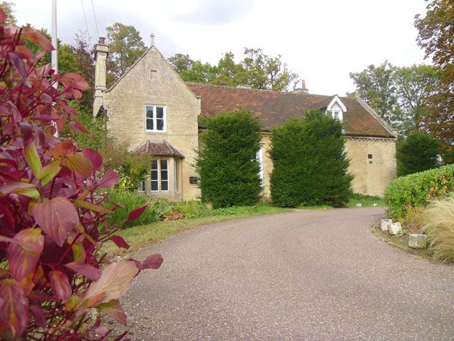
Heritage Policy

Slide 17
Heritage Policy
H 2
All village assets that are to be modernised, renovated or altered should be designed with careful regard to the historical structure, architectural interest and setting.
Any development of a village assets must enhance the historical value of the building.
Any development of the Duke of Bedford Cottages in Oakley must retain their historical and architectural interest and setting.
Oakley War Memorial is a unique feature of individual design and must be retained.
Lovell Homes is a unique example of memorial houses C1930s and must retain their historical, architectural interest and setting

Slide 18
Heritage Areas
Heritage Areas
Flood Zone
Current Settlement Area
Contains OS data © Crown copyright and database right (2017)

Slide 19
Local Green Spaces
Grange Close Green, bounded by Station Road, Reynes Drive
Oakley Sports and Social Club, Church Lane
Linch Furlong Nature Reserve, Pavenham Road
Adjacent to the Great River Ouse
Judges Spinney, Highfield Road
Allotments and Community Orchard, Pavenham Road
Copse/woodland in Westfield Road
Field to the rear of Church Lane, north of the River
The field adjacent to houses and schools in Station Road, next to the Midland main line railway line and also Lincroft New Field
Browns Wood
Paddock and Orchard Associated with Middle Farm
Village Green

Slide 20
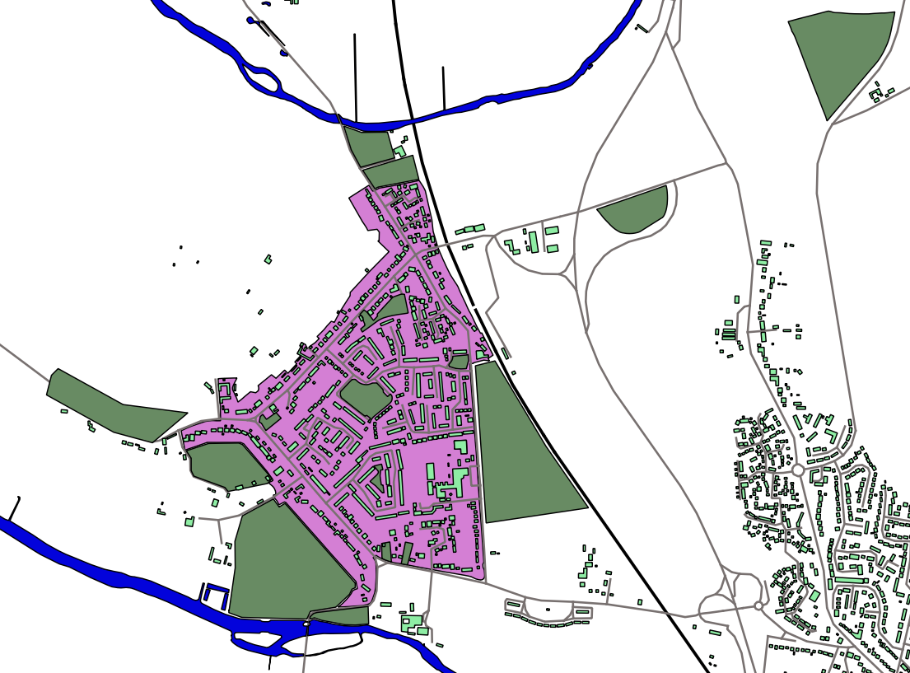
Green Spaces
Proposed Green Spaces
Current Settlement Area
Contains OS data © Crown copyright and database right (2017)

Slide 21
Local Green Spaces
GS 1 Future development should not take place on the Local Green Spaces detailed on the policy poster and identified on Map (Green Spaces)
GS 2 Any new development should provide sufficient green spaces, in keeping with the current village design.

Slide 22
Green Spaces
Proposed Green Spaces
Current Settlement Area
Contains OS data © Crown copyright and database right (2017)

Slide 23
Landscape and Environment Development Policies
LE 1
Development within Oakley Parish boundary will conform to the development guidelines laid out in the Oakley Village Landscape Character Assessment supported by the Bedford Borough Landscape Character Assessment.
LE 2 The River Valley
The river and river valley area throughout the parish will be protected from development.
LE 3 The Limestone Bridges
3.1 The ‘Two Bridges’ Approach into Oakley from Bromham
No development will be allowed which impinges upon the views between St. Mary’s Church and the Two Bridges to/from Bromham or upon the long views up and down the river from the Bridges as described above.
3.2 The Stafford Bridge
The landscape settings surrounding the Stafford Bridge, including Linch Furlong and the allotments, will be protected from development.

Slide 24
Landscape and Environment Development Policies

Slide 25
Proposed Development Sites
Proposed Sites
Current Settlement Area
Contains OS data © Crown copyright and database right (2017)

Slide 26
Landscape and Environment Development Policies
LE 4 Long Views to and from Oakley
Development will not be permitted that will impact upon the Long Views to and from Oakley.
LE 5 Coalescence with Neighbouring Villages
To prevent coalescence with neighbouring village Clapham, no development will be permitted on the area of land east of Station Road opposite the schools, extending from the Old Station in the north, to Lovell Road in the south.
LE 6 Linear Extension of Oakley
The linear extension of Oakley along the entrance roads will be restricted for the reasons identified in the Oakley Village Landscape Character Assessment above.

Slide 27
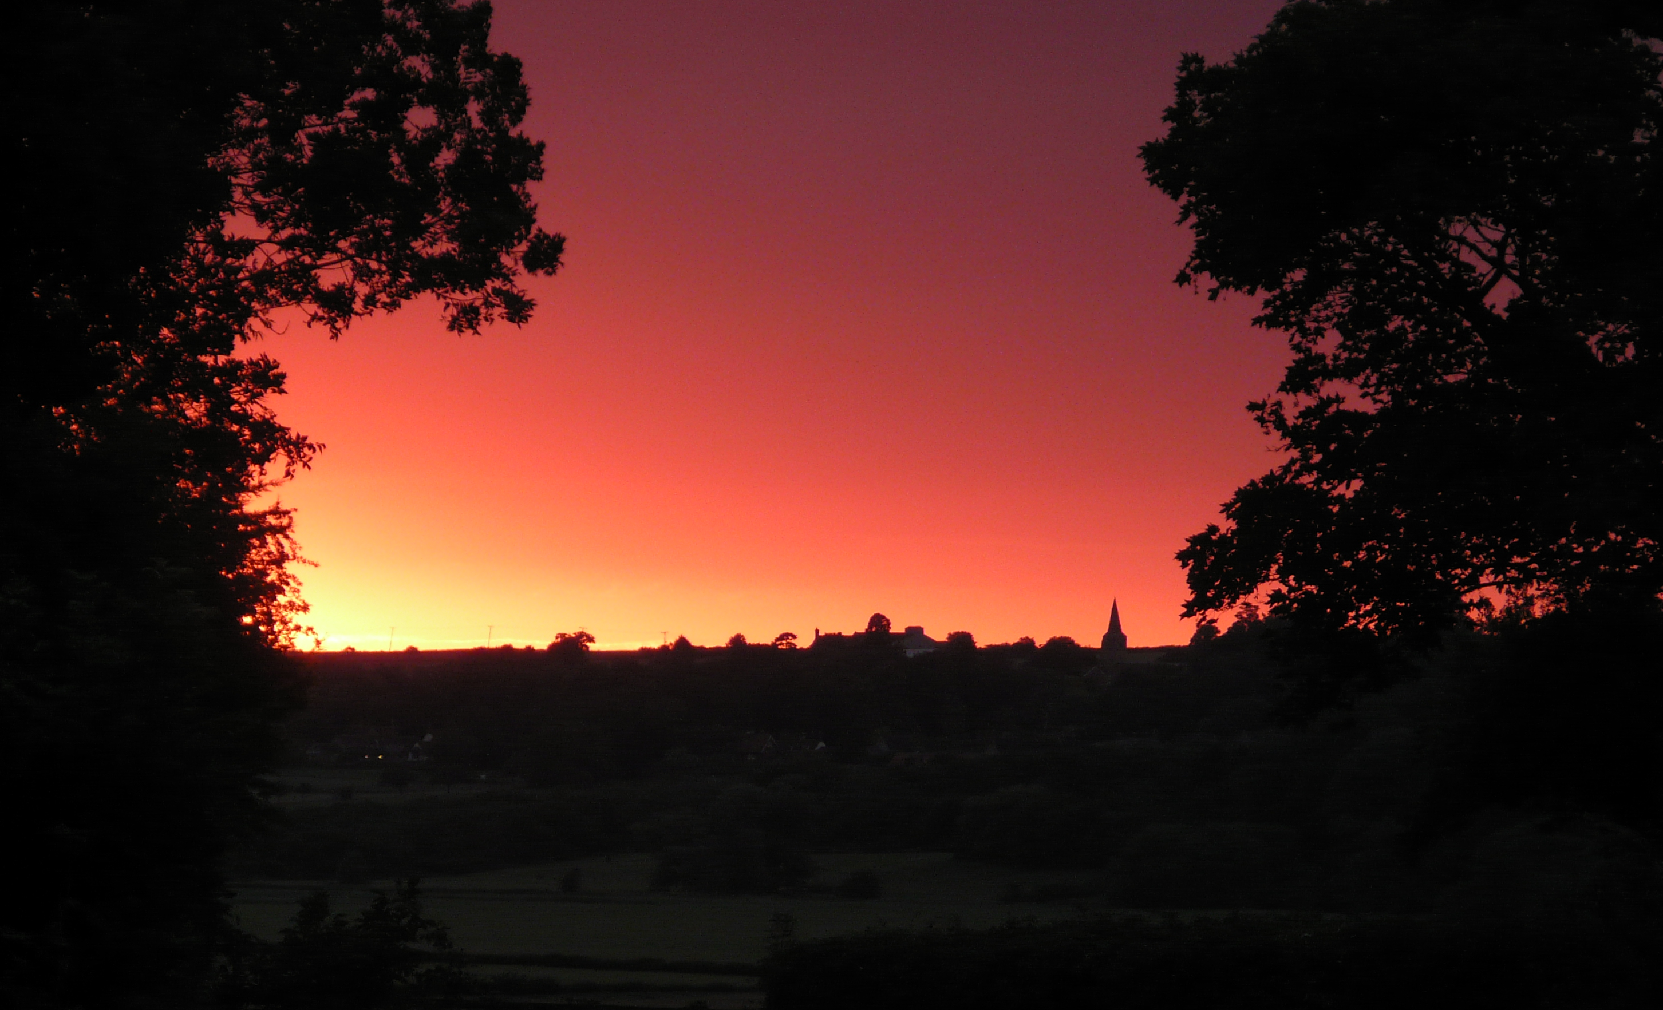
Landscape and Environment Development Policies

Slide 28
Proposed Development Sites
Proposed Sites
Current Settlement Area
Contains OS data © Crown copyright and database right (2017)

Slide 29
Landscape and Environment Development Policies
LE 7 Conserve Rural Village Identity
To preserve the rural identity of the village, the following policies will be adopted:
7.1 New development will conform to the local vernacular with respect to boundary identification, i.e. hedges, walls and fencing.
7.2 Future development of the village will incorporate the following:
a) Excessive signage will be avoided,
b) Street lighting will be minimal, sympathetic with the local setting and in line with the village identity,
c) New development will conserve the rural character of the roads in the village.
7.3 The following will be protected:
a) Hedges lining the front gardens on principal roads,
b) The open, semi-rural character of the centre of the village and village green.
c) The semi-wooded areas of the village and the hedges lining the principal access roads.

Slide 30
Landscape and Environment Development Policies
LE 8
8.1 No development will be allowed which will damage the woodland areas or the setting of Browns Wood and Judges Spinney.
8.2 No development will be allowed which will damage the long views to or from Browns Wood and Judges Spinney.

